Slide 1



Diversity and Inclusion
We strive to host inclusive, accessible events that enable all individuals to engage fully.
If you have a concern, if you need an accommodation for a disability, or if you would like to learn more, please talk to one of our Microsoft staff on-site and we’ll do our best to assist you.
Thank you.
Practice
Awareness
Exercise
Curiosity
Demonstrate
Courage

Slide 2

GPU Accelerated IoT Workloads at the Edge
Paul DeCarlo Principal Cloud Advocate
@pjdecarlo
Presentation available @ aka.ms/intelligentedgeholdeck

Slide 3
Demo
YoloV3 IoT Edge Module Running on Jetson Xavier

Slide 4
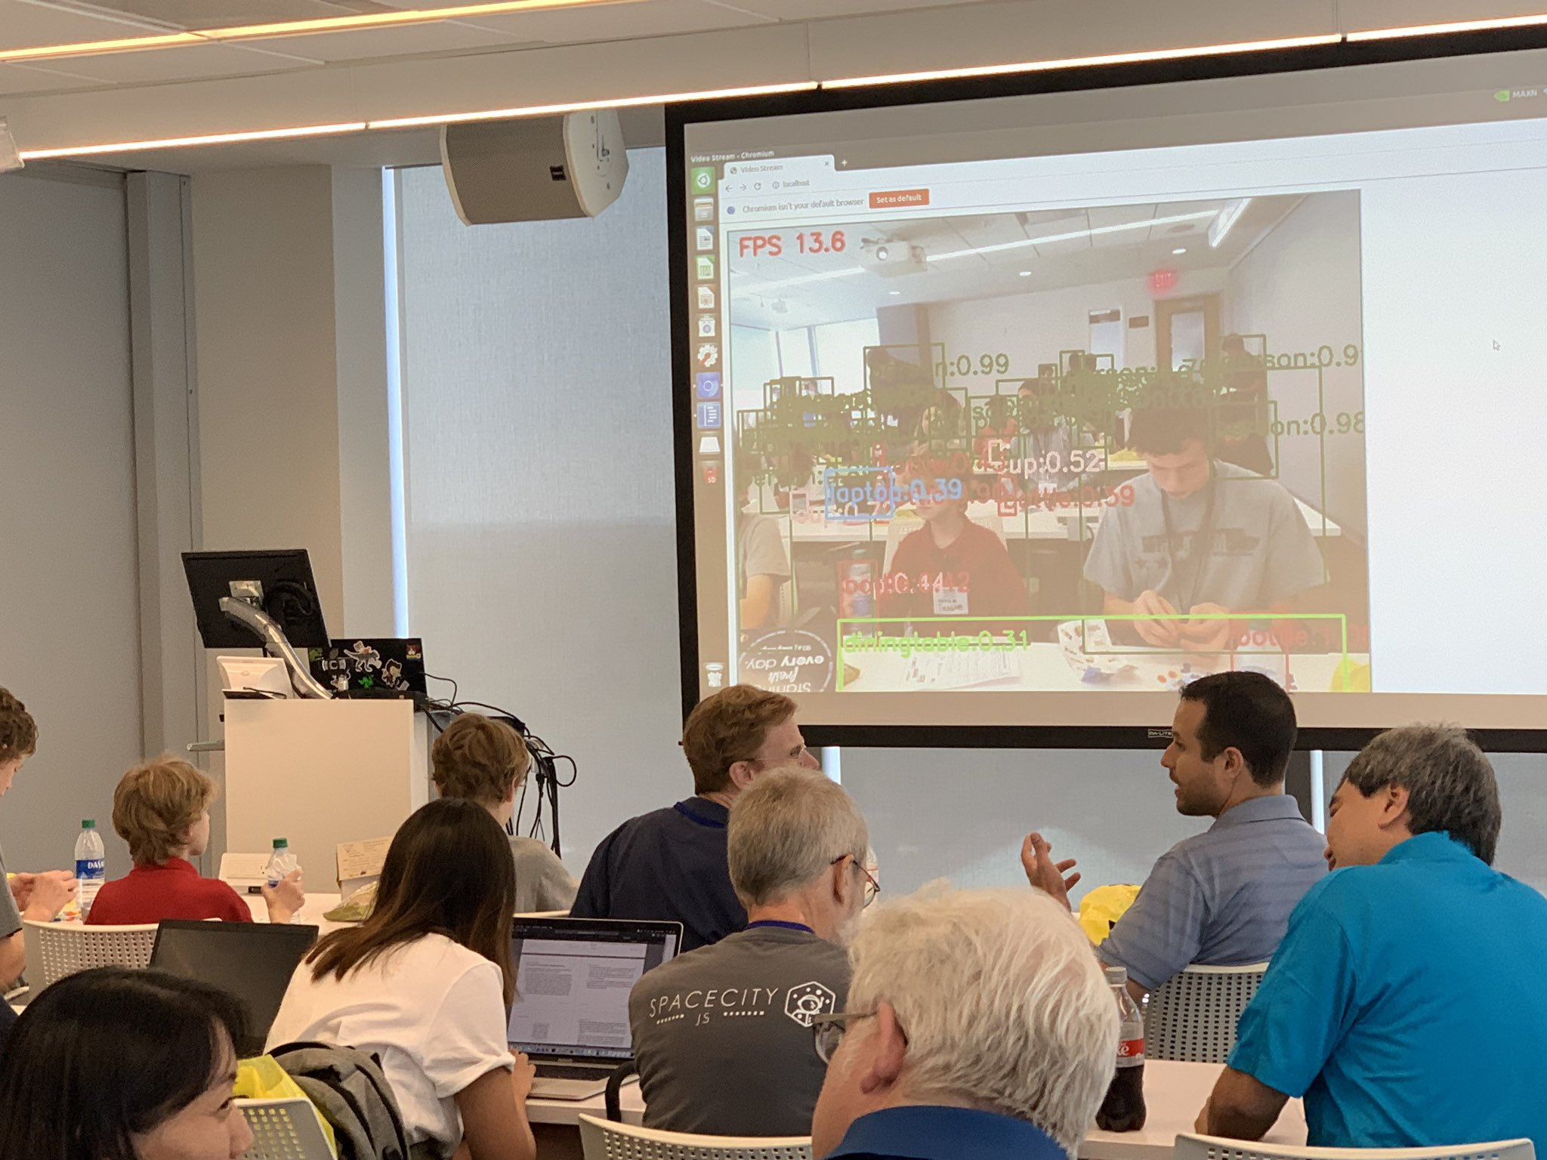
YoloV3 IoT Edge Module Running on Jetson Xavier

Slide 5

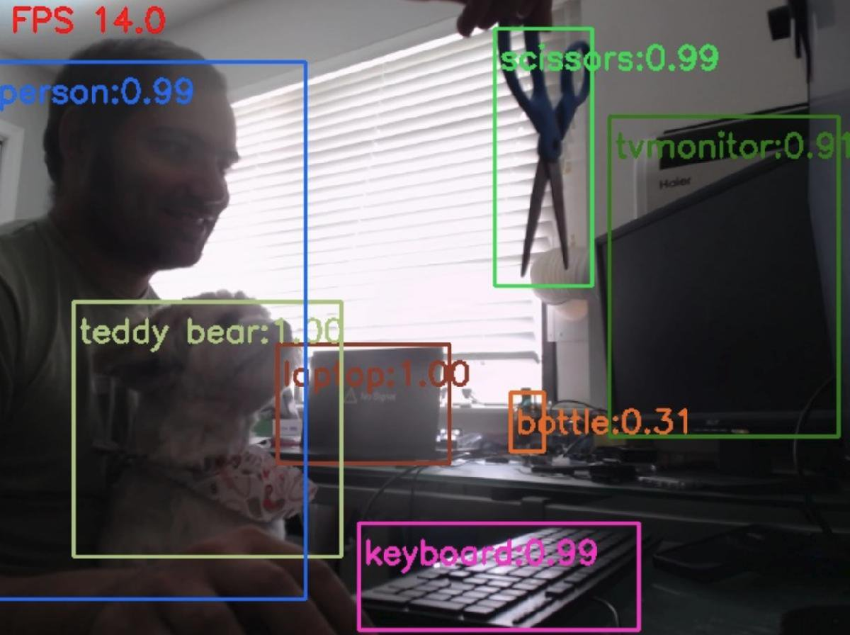
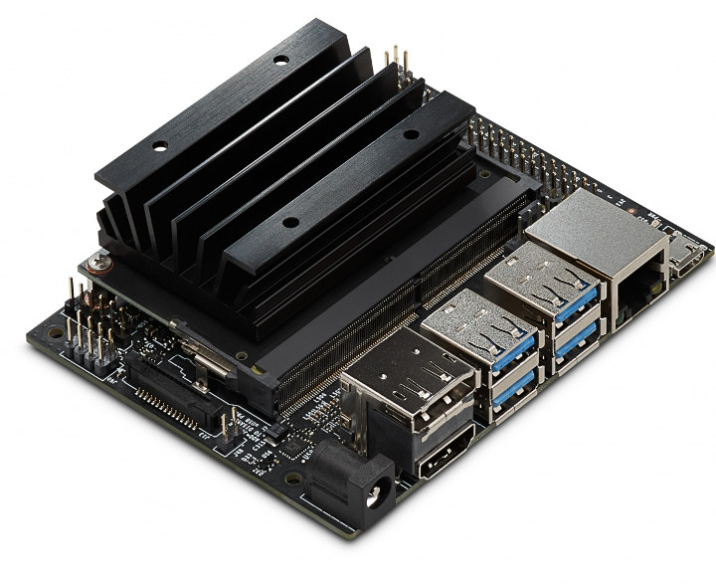



Agenda
Introduce Azure IoT Edge
Introduce Nvidia Jetson Devices
Developing IoT Edge Modules with GPU acceleration
Intelligent Edge Hands-On-Lab
Additional Resources

Slide 6
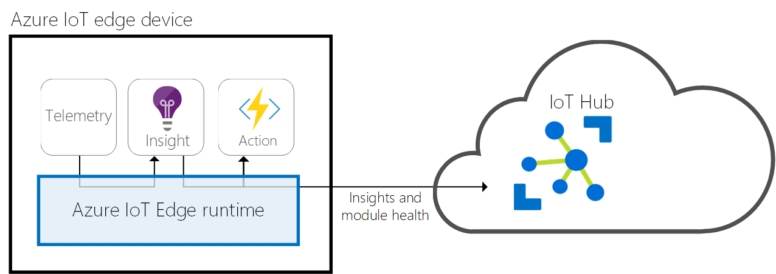
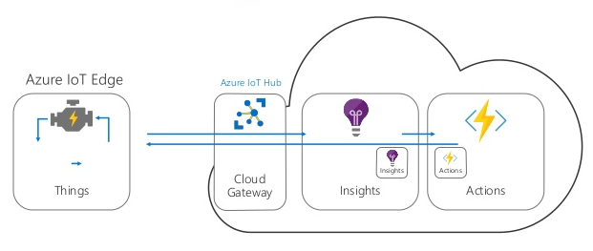
Azure IoT Edge
Built on container technology as ‘modules’
Modules support Python, NodeJS, .Net Core, Java, & C
Low-latency AMQP / MQTT data transport
Operate in offline / intermittent network conditions
Supports Linux X64 | ARM32/64 , Windows X64
OSS and available @ https://github.com/Azure/iotedge

Slide 7
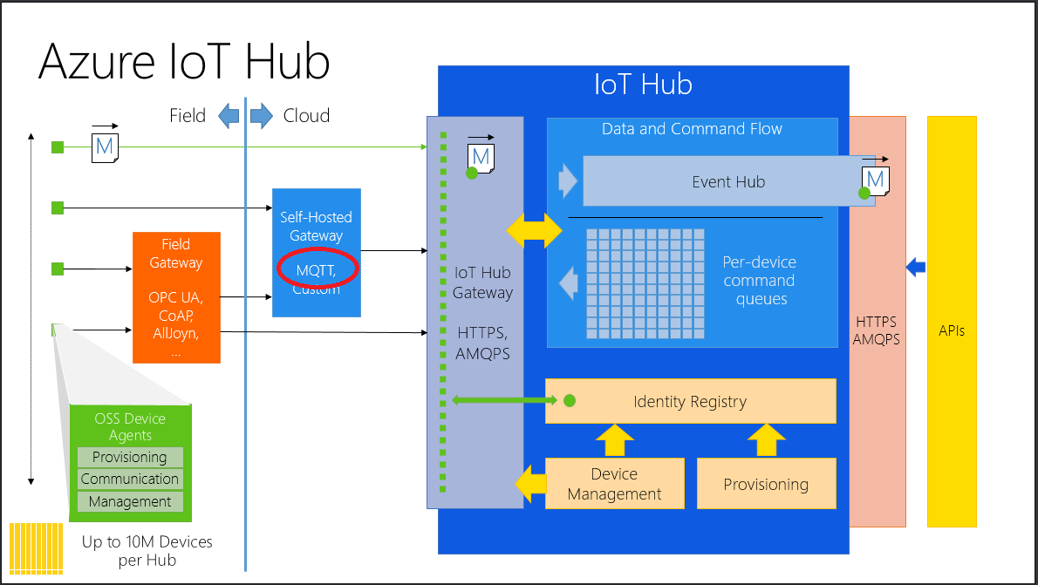

Slide 8
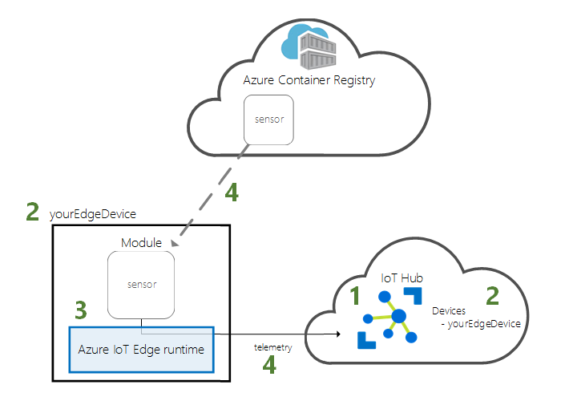
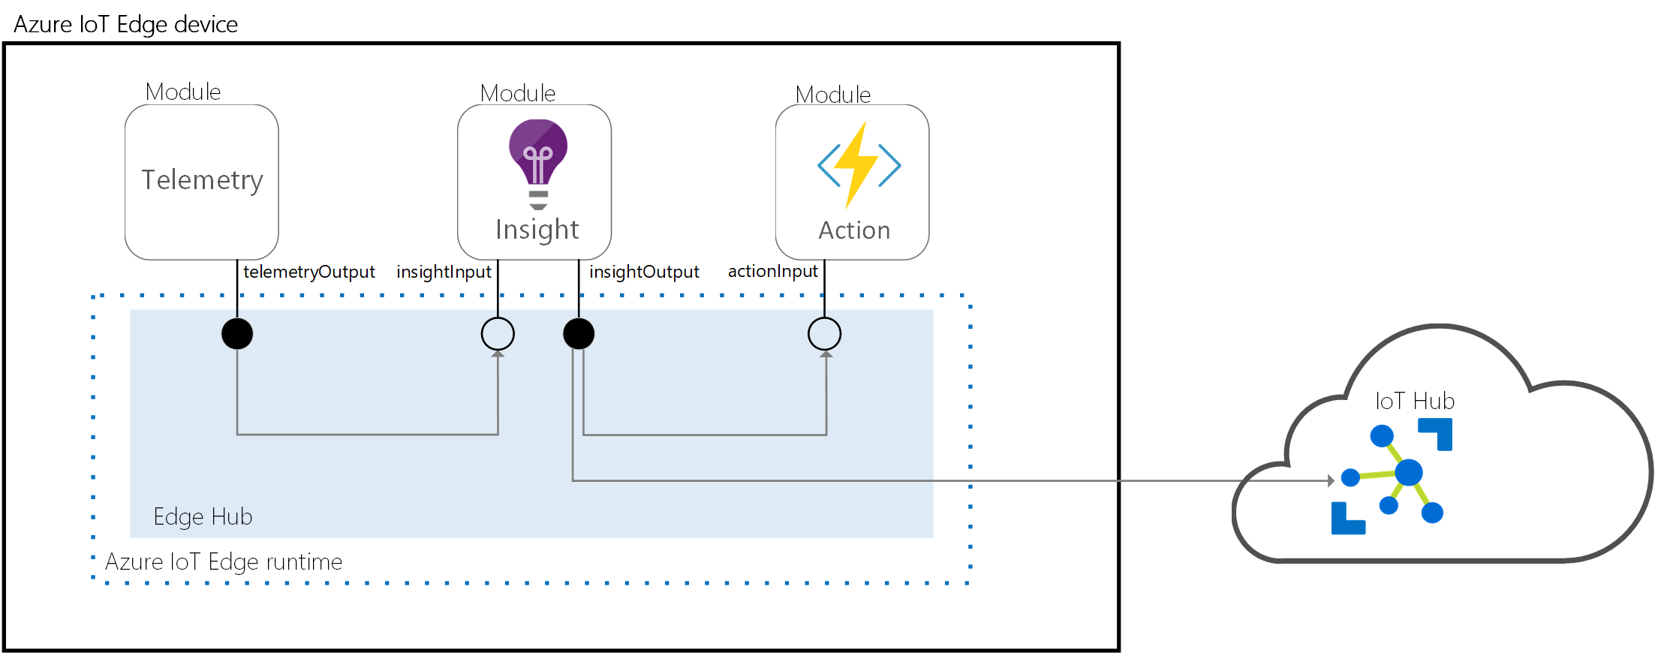
System Modules
edge-agent:
Deployment & Container orchestration
Ensures module uptime
edge-hub:
Communication to/from Azure IoT Hub
Inter-module communication

Slide 9
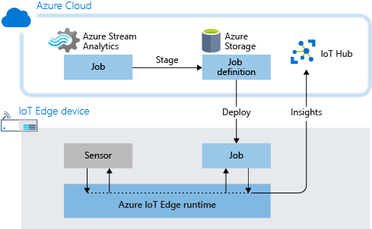
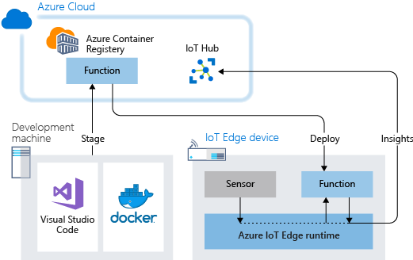
Azure Services as Edge Modules
Azure Stream Analytics
Azure Functions

Slide 10
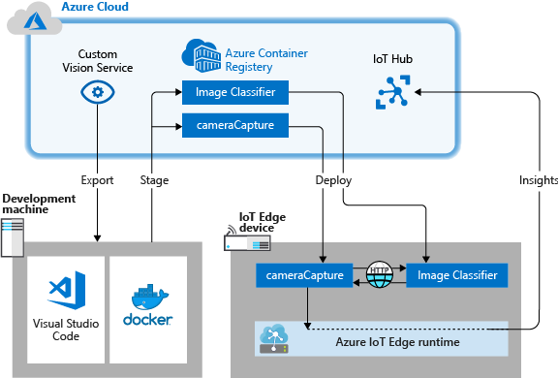
AI/ML Modules
Cognitive Services including:
Text Analytics - Key Phrase Extraction, Language Detection, Sentiment Analysis
Face – Detection, Verification, and Emotion
Computer Vision – Text Recognition, custom vision module allows to finds whatever you train it to find
Azure Machine Learning at the Edge
Export AML models to run a Edge modules

Slide 11
IoT Edge Deployment Process

Slide 12
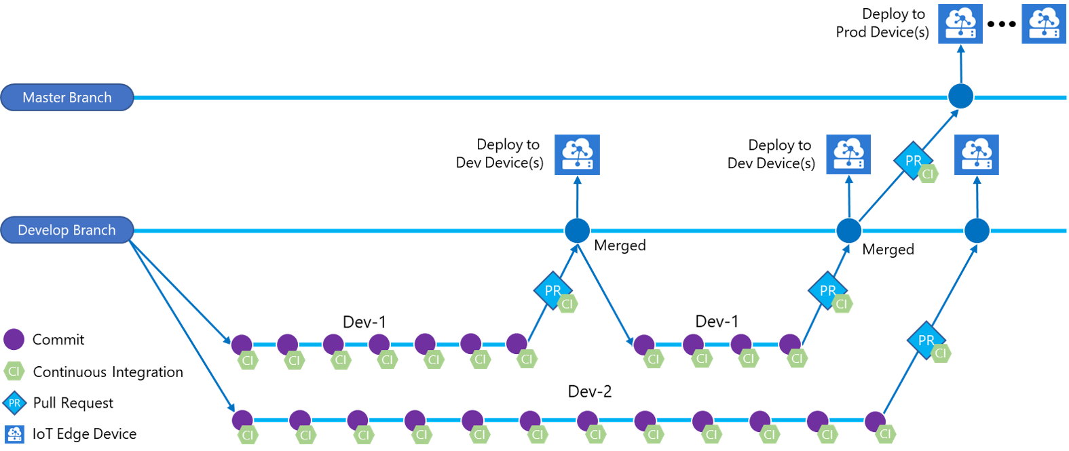
DevOps Process with IoT Edge

Slide 13
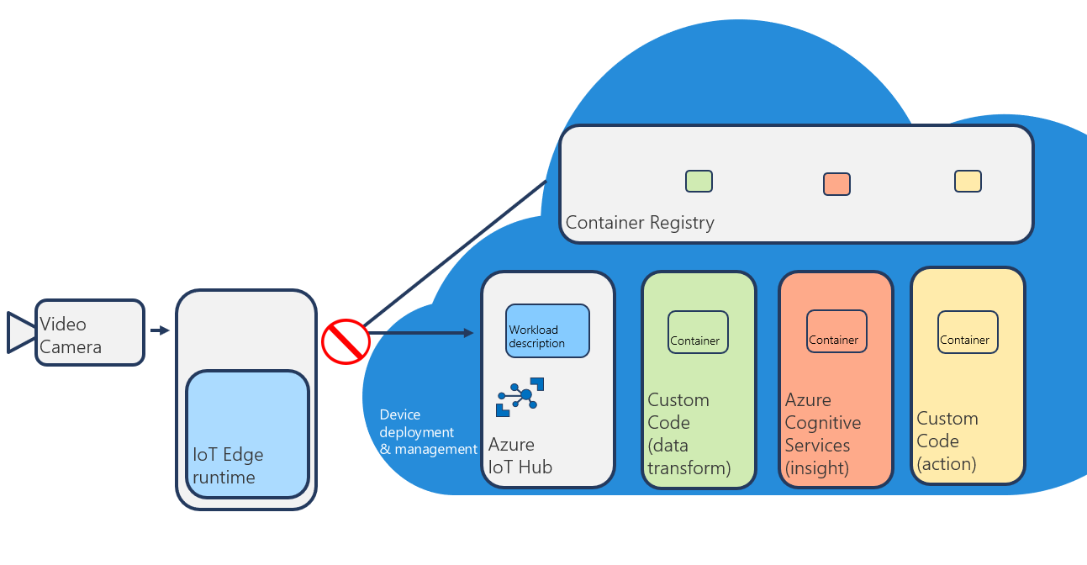
Edge intelligence enabled with Azure IoT Edge
Notes:
Start with an IoT workload designed for smart cameras that you may run in the cloud. First, custom code is used to massage the camera data into a format usable by some high value AI, in this case an image recognition model created by Azure Cognitive Services. This AI produces an insight which triggers an action.
The first step to getting this to run on the edge is to containerize portions of the workload and place that in a container registry.
You then create a workload description in the cloud and target it at the correct types of IoT Edge devices. After all, you don’t want your smart camera workload running on your smart oil pump.
When an IoT Edge device connects to IoT Hub, IoT Hub determines there are any workloads appropriate for IoT Edge device.
The correct workload description sent to the IoT Edge device. The IoT Edge device then downloads the containers that compose that workload and start the workload, and then report status of the workload back to the cloud. Just deploying workloads to the edge isn’t enough! You have to understand if your solution is working correctly and take appropriate if it is not.
IoT Edge will continue to ensure that the workload (AI, actions, and all) continues to run locally on the device, even in the event of an internet failure. It’s even smart enough to cache data that was bound for the cloud when the internet connection was down and sync it once reconnected!

Slide 14
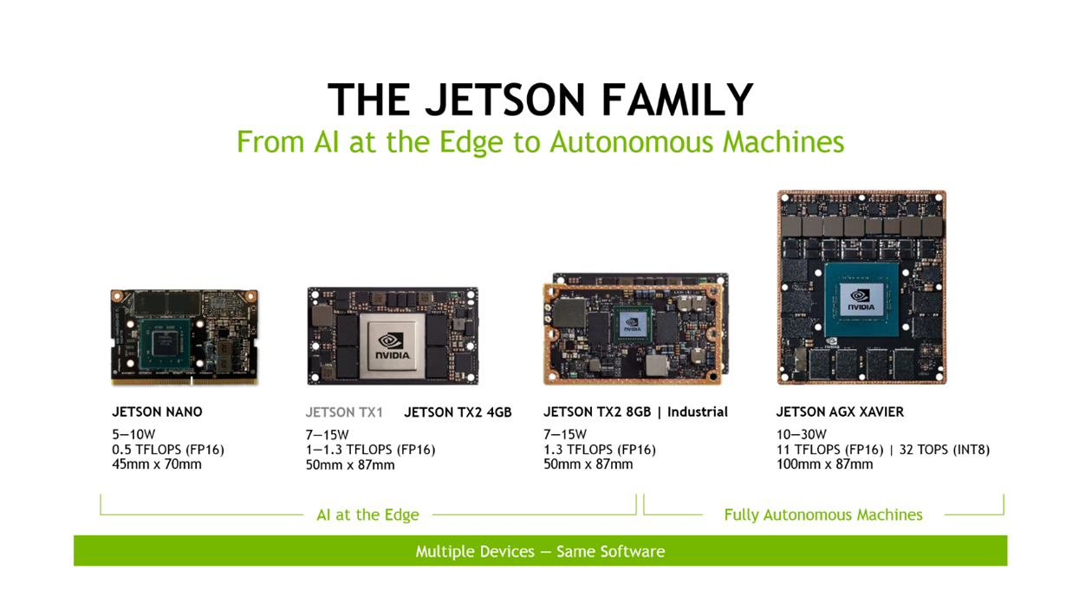

Slide 15
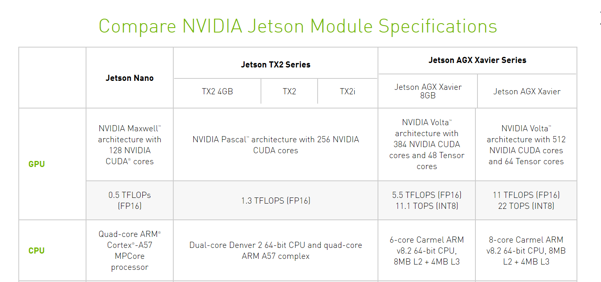

Slide 16
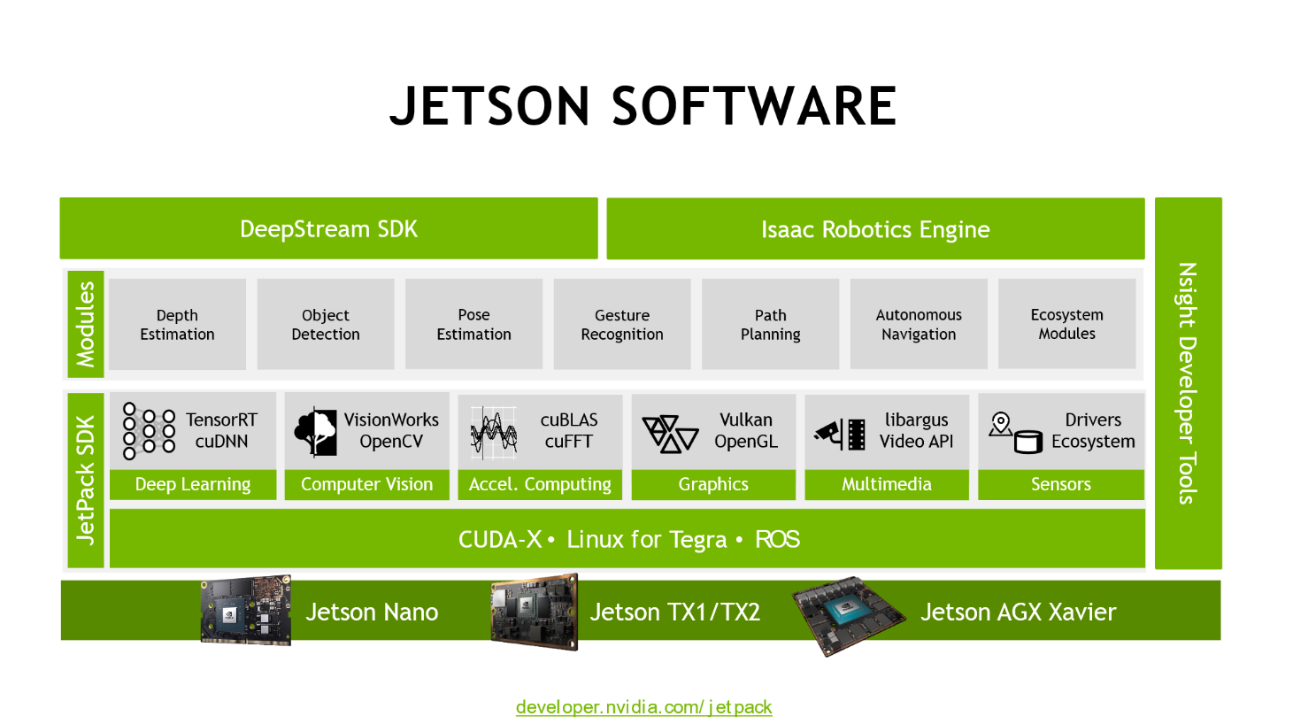

Slide 17
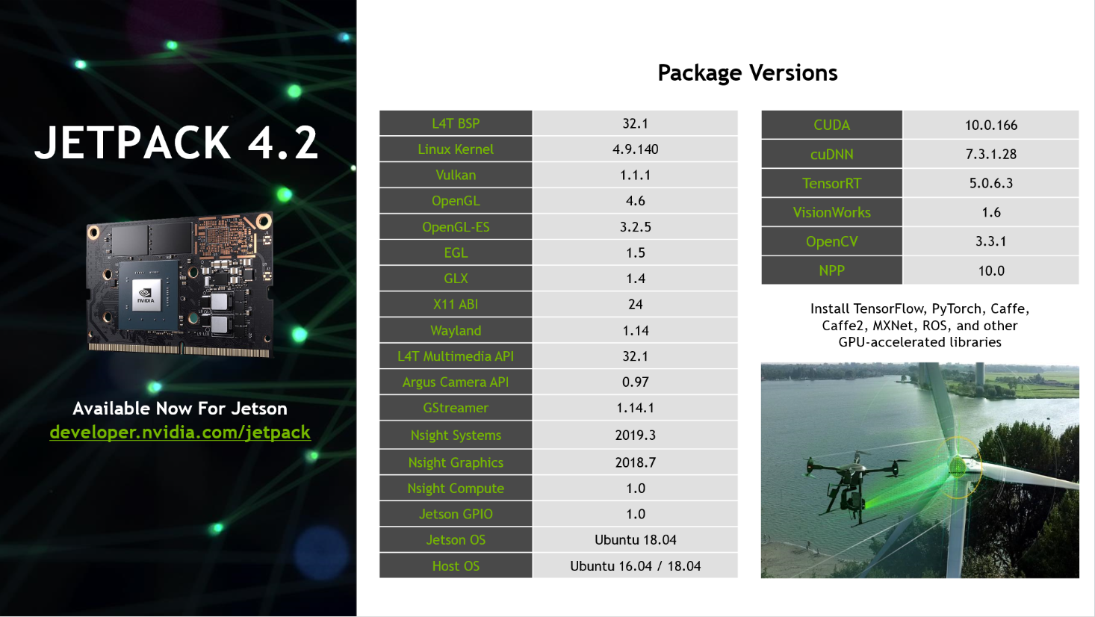

Slide 18
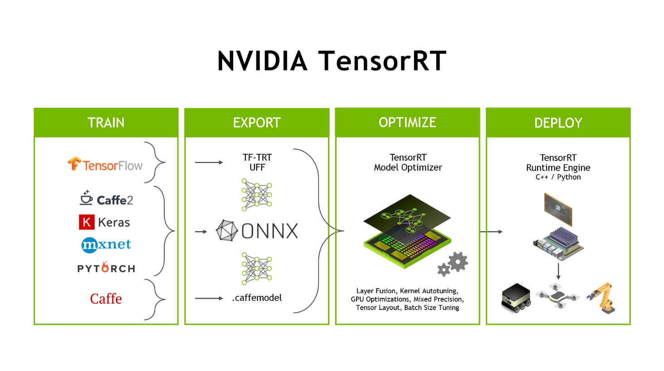

Slide 19
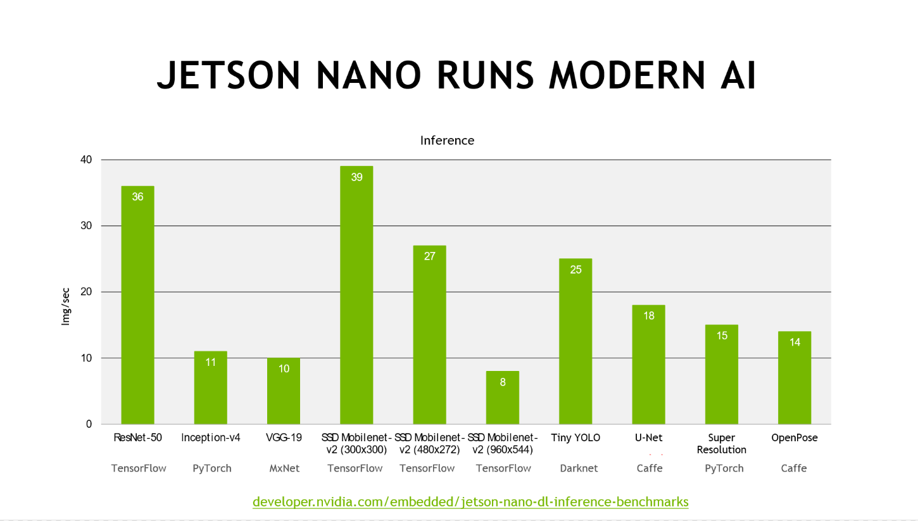

Slide 20
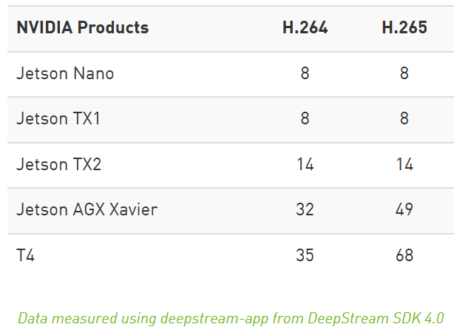
Achieving Real-Time Performance
Number of 1080p/30 FPS streams processed on various platforms.

Slide 21
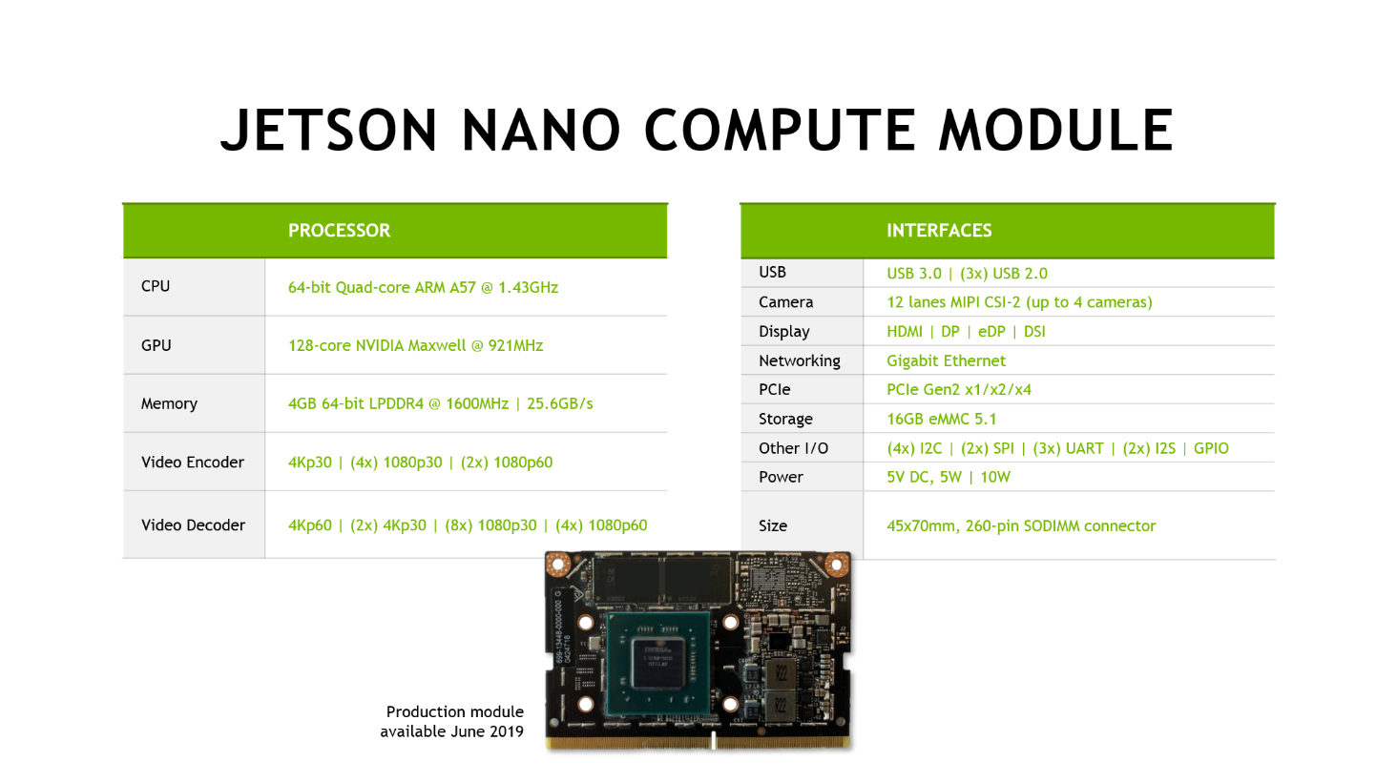

Slide 22
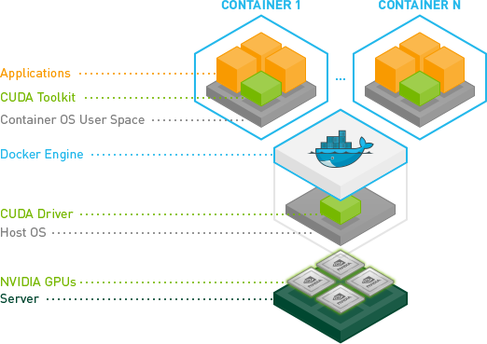
Nvidia Docker
CUDA Driver resides as part of the Host OS
At runtime, nvidia-docker mounts CUDA Driver and adds devices to container
Allows container to leverage GPU capabilities

Slide 23
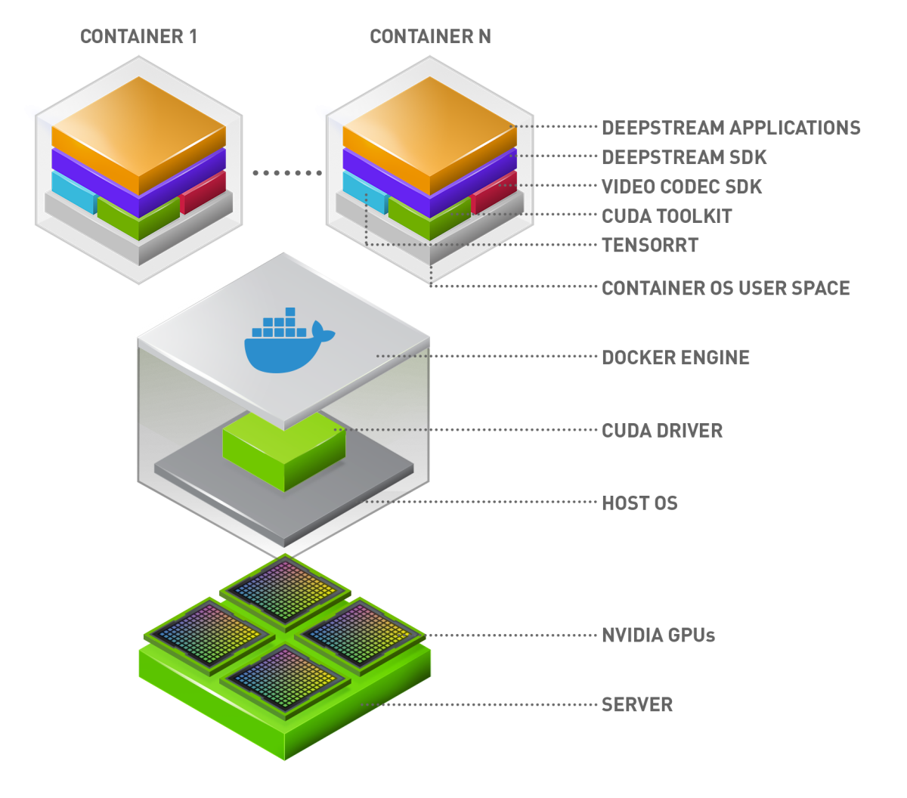
Deepstream Module
Works on same principal as Nvidia Docker
Contains Deepstream Application which is driven by a config file
Supports messaging to Azure IoT Hub from Deepstream App

Slide 24
Demo
Nvidia Deepstream on Jetson Xavier

Slide 25
Video
Vision IQ Solution by the Marsden Group

Slide 26

Additional Resources
Further Learning
Onnx-runtime-iotedge:
https://github.com/Azure-Samples/onnxruntime-iot-edge
Use onnx models with webcam input on Nano with IoT Edge
Ian Davis’s blog:
https://codepyre.com/
Contains info on building custom RootFS / Tensorflow
Paul DeCarlo’s Dev.to articles:
https://dev.to/toolboc
Articles related to IoT Edge Development on Nvidia devices
This powerpoint presentation:
http://aka.ms/IntelligentEdgeHOLdeck
Video recording of this presentation:
http://aka.ms/IntelligentEdgeHOLvideo

Slide 27
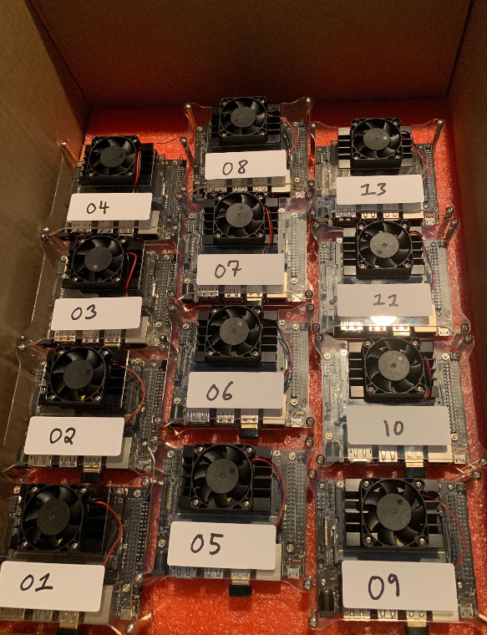
Bill of Materials
Hardware Checklist
Jetson Nano DevKit - https://amzn.to/2WFE5zF
Jetson Nano Case + Fan - https://amzn.to/2ZI2ki9
Jetson Nano 4V 2A barrel adapter - https://amzn.to/32DFsTq
Micro Jumper - https://amzn.to/2SoyPQa
128GB MicroSD card - https://amzn.to/32zj0ep
Edimax WiFi Adapter - https://amzn.to/2SuDXT8

Slide 29
Reminder about confidentiality
The information presented today is Microsoft Confidential Information. Any leak of this confidential information could seriously impact Microsoft’s product plans, which would be a detriment to both of us.
Therefore, we remind you that you may not share this information with anyone outside your organization and only with those who have a legitimate need to know.
And please no blogs, tweets, posts, or photos during the presentation as confidential information can easily be lost by these methods.
Thank you.
*

